Slide 1
Mixtures of Gaussians and the EM algorithm
Tine

Slide 2
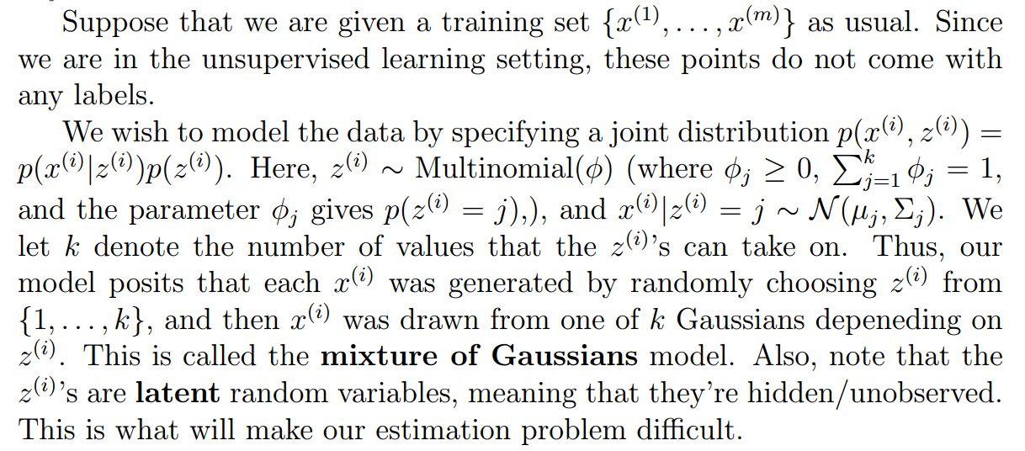
Mixtures of Gaussians

Slide 3
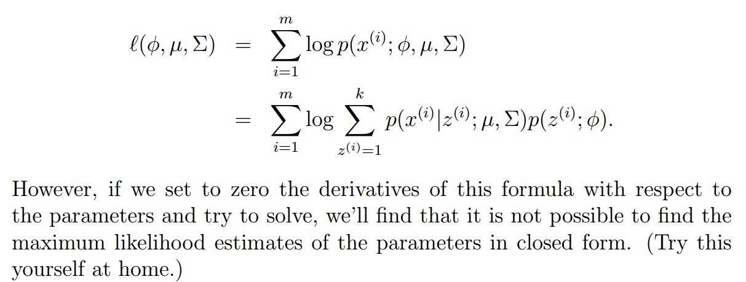
the likelihood of our data

Slide 4
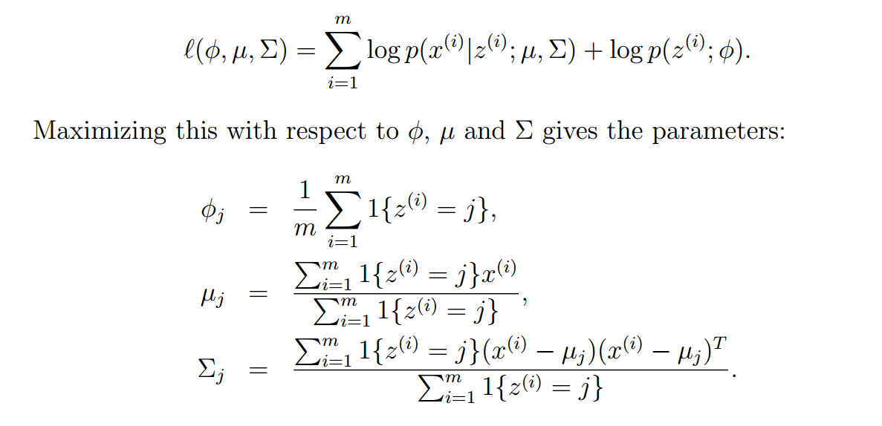
Note that if we knew what the z(i)’s were, the maximum likelihood problem would have been easy.
However, in our density estimation problem, the z(i)’s are not known. What can we do?

Slide 5
The EM algorithm
The EM algorithm is an iterative algorithm that has two main steps. In the E-step, it tries to “guess” the values of the z(i)’s.
In the M-step, it updates the parameters of our model based on our guesses.

Slide 6
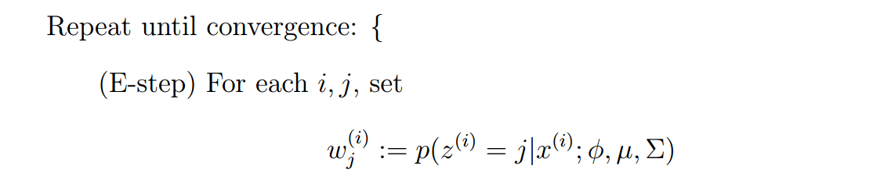
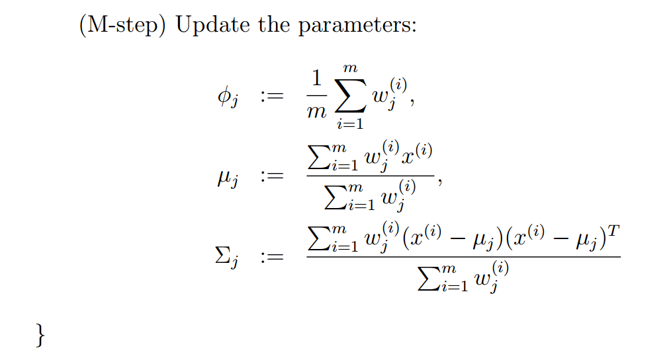

Slide 7
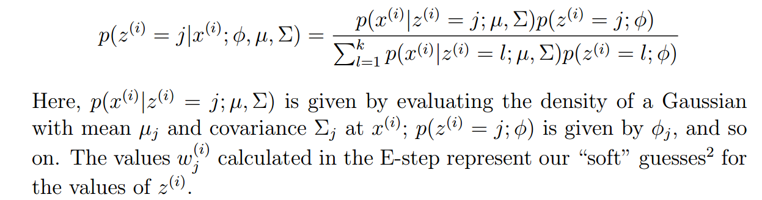
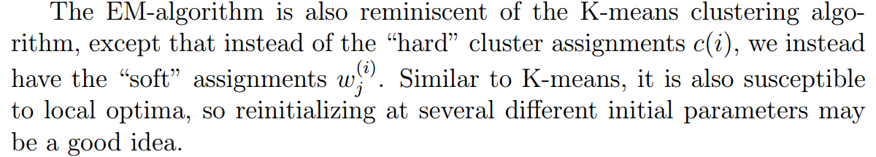

Slide 8
It’s clear that the EM algorithm has a very natural interpretation of repeatedly trying to guess the unknown z(i)’s
EM will allow us to easily apply it to other estimation problems in which there are also latent variables, and which will allow us to give a convergence guarantee

